Slide 1

Wellness Queue
Submitted by
Binary Nova Team
Ananya Stitipragyan astitipr@in.ibm.com Commander: Supriya Sinha supsinha@in.ibm.com IBM India pvt ltd. WiT Covid-19 warrior Hackathon

Slide 2

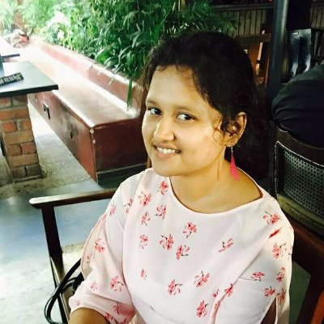
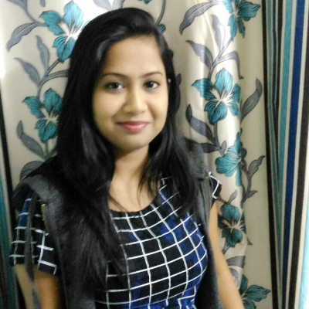

Binary Nova Team
Ananya Stitipragyan
Supriya Sinha
Data Scientist(Developer)
Application Architect(Developer)
Company: IBM Experience:3+ years Education: Mtech/Btech Computer Science Engineer from IIIT-Bhubaneshwar Skills: java, python, Watson APIs
Company: IBM Experience: 4.8 years Skills: Java and Android, Spark, hbase, Hadoop, Kafka and IBM Streams.
working on frameworks like Spring, Hibernate., Angular JS, HTML5, JavaScript

Slide 3
Wellness Queue
Automation virtualizes the waiting Queue
At medical centers, Labs and hospital

Slide 4

About Existing Procedure
The existing PCR test is registered through a self reporting form for COVID-19 Sample collection
After submission of the form the mobile number provided in the form gets the OTP , id, Sample ID as a text message.
They also get a link to download ICMR Specimen Referral Form For Covid-19(SARS-CoV2)
At Medical centers and collection centers they do not have the real-time tracking application for queue status while waiting at the quarantined place for their turn to appear.

Slide 5

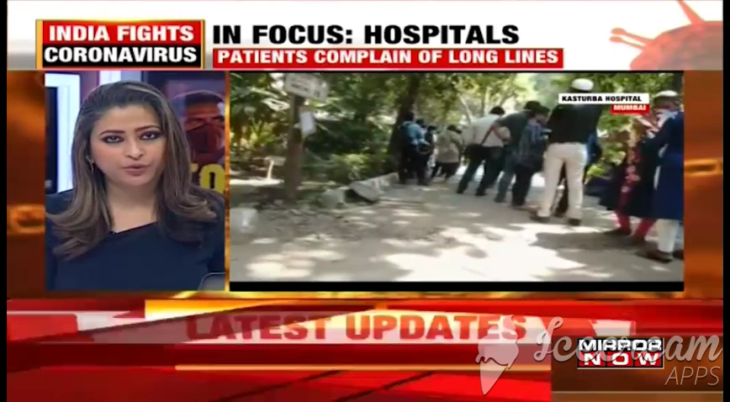
The Problem
Problem statement:
The Medical centers and collection centers do not have the real-time tracking application for queue status while waiting at the quarantined place for their turn to appear.

Slide 6
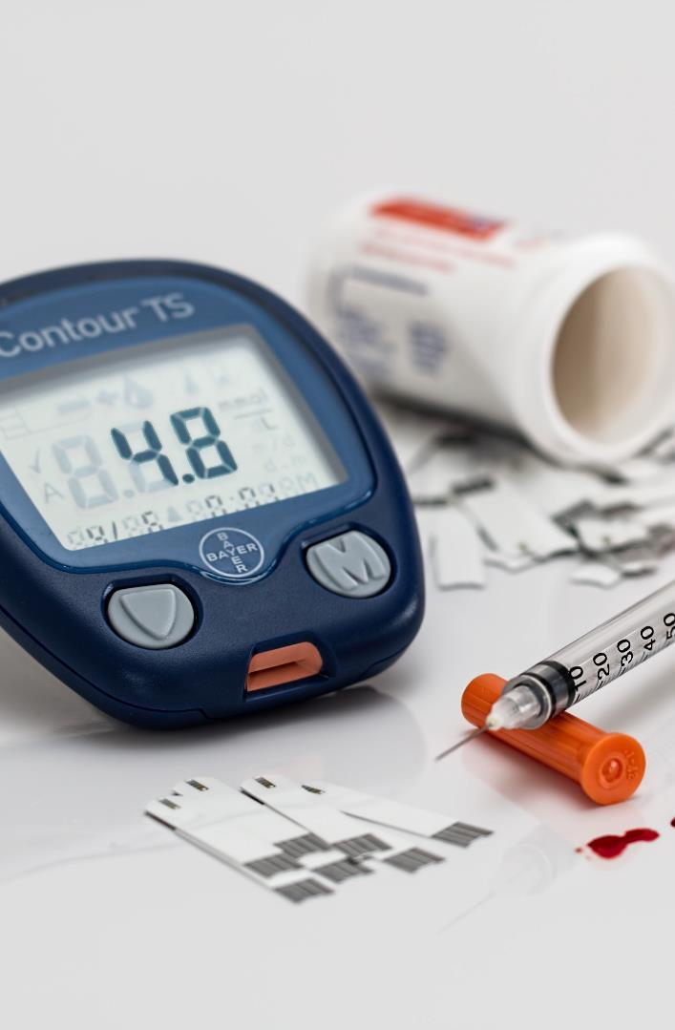
Solution
WellnessQ automates the queue into virtual one so that the patient does not have to stay anxious for its turn for long. It can track the people those are there before and stay alert about its turn. we as well as send the certificate of people who tested negative. Apart from the Covid-19 patients, it can also help the other category of health department. which will facilitate patients to stay safe while maintaining safe social distancing.

Slide 7
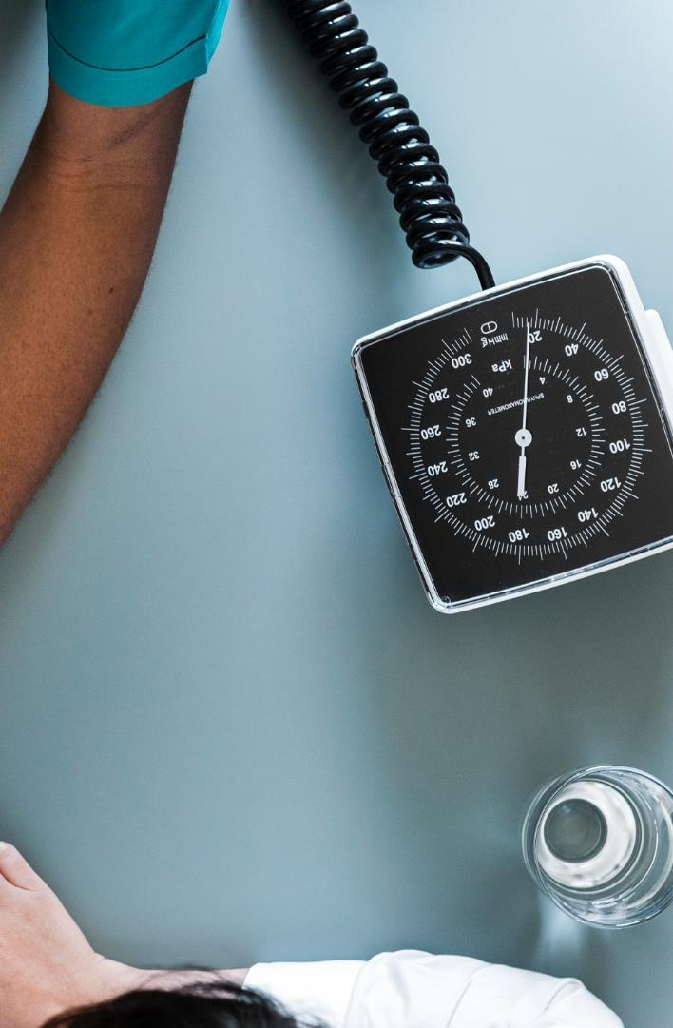
WellnessQ
1. Multiple categories: one category will be covid19
2. Inside that the user has to answer certain questions
3. Recommend the user with the list of test/Health facility centers near
4. Option to select an appointment slot time 5. In that slot, option to view number of people in Queue
6. Request for queue Token 7. Option track users turn 8. Responsive notification alert
9. Downloading certificate for Tested negative reports
Team Binary Nova

Slide 8


RoadMap
Analysing the need for virtual queue at Wellness center
Designing service integration and software solutions
Installation setup of deployable spring boot backend and native android
API development Connection to MongoDB
Android Frontend login and dashboard
integration
Review Android app and Deploy
Kudos! Completed
WellnessQ Feature testing and Development
FCM Location service enablement and push notification setup

Slide 9
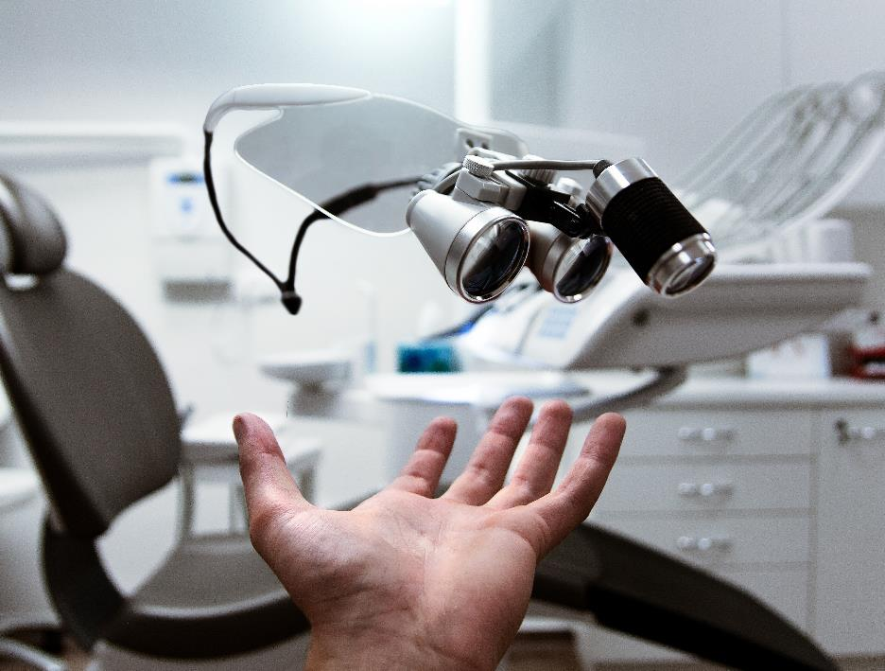


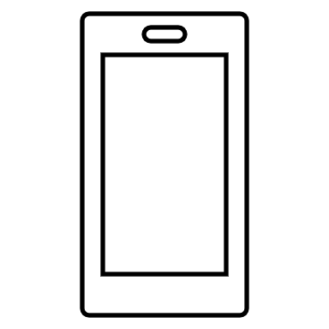



Emphasize your main benefit
Nearby Health centre availability suggestion
WellnessQ App
Search available Medical centres and labs
Use your time wisely
Medical representative can monitor the queue tokens using this application
Patient can wait at a safe distance as per its convenience
Wait time stress reduction due to real-time alerts
Certificate for negative reported people
Get real time Queue Token alert

Slide 10


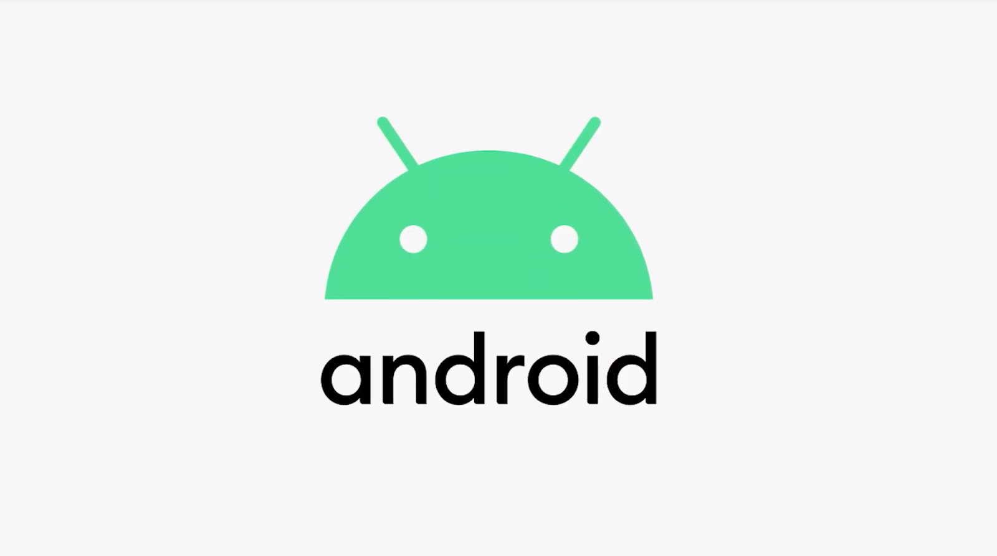






Queue Tokens
C
L
OUD
IBM Cloud Foundry Application
8
<Rest APIs>
5
JAVA Spring Boot backend
Android Native Application
6
IBM cloud push notification
Google map
MongoDB Atlas
FCM
3
Doctor
Patient
Users
Department

Slide 11

Database Model
Patient
String name
String email
String password
String latitude
String longitude
String queueToken
String ewt <estimated waiting time>
List<Doctor> historyOfVisits
Doctor/Medical Representative
String name
String category/department
String lattitude
String logitude
String timeslot
Long queueToken
Long queueCapacity
Long totalQueueRequests
Category/Department
String name
String description

Slide 12
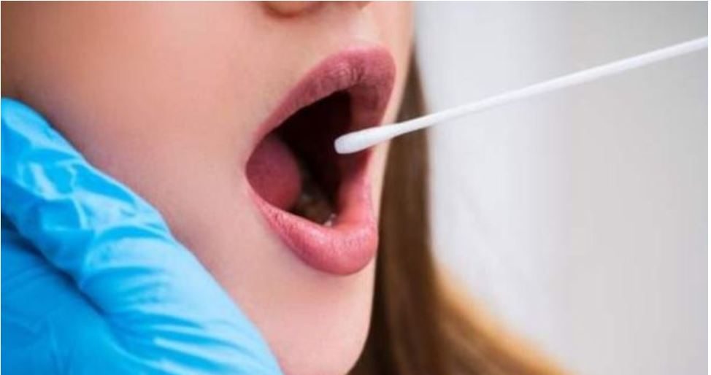
WellnessQ Solution Flow
login Name,Number,OTP
Search and Select Health Department, Doctors
Request Queue Token Book an appointment, Track the queue
Generate OTP
Login using OTP
Select type 1.Doctor 2.Patient
Edit profile
View Notification
Logout
View All Health Category
View All Doctor
Search available Doctor for a particular category and timeslot
View number of appointments already taken for a particular time slot
Request for Queue
Delete your request
Get real-time notification when queues are updated

Slide 13
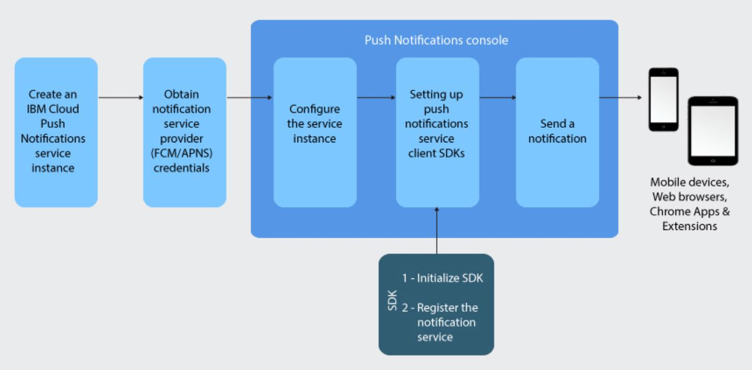
IBM Cloud Push Notifications
1. Scalable and reliable Push Notifications service for mobile and web applications
2. Enables you to analyze the number of devices that are registered to receive notifications and the number of notifications sent
3. Ability to personalize and send notifications to a segment of users, single user or broadcast to all users
Service Provider
IBM

Slide 14
1.Firebase Phone Authentication
1.FCM phone based Authentication
-OTP based service enablement
2.Android cloud IBM Push notification
Service integrated with FCM
3.Google Maps
Connected to Android Application
4.Retrofit used for API call
Retrofit is a REST Client library (Helper Library) used in Android and Java to create an HTTP request and also to process the HTTP response from a REST API
2.Google Map
Integration

Slide 15

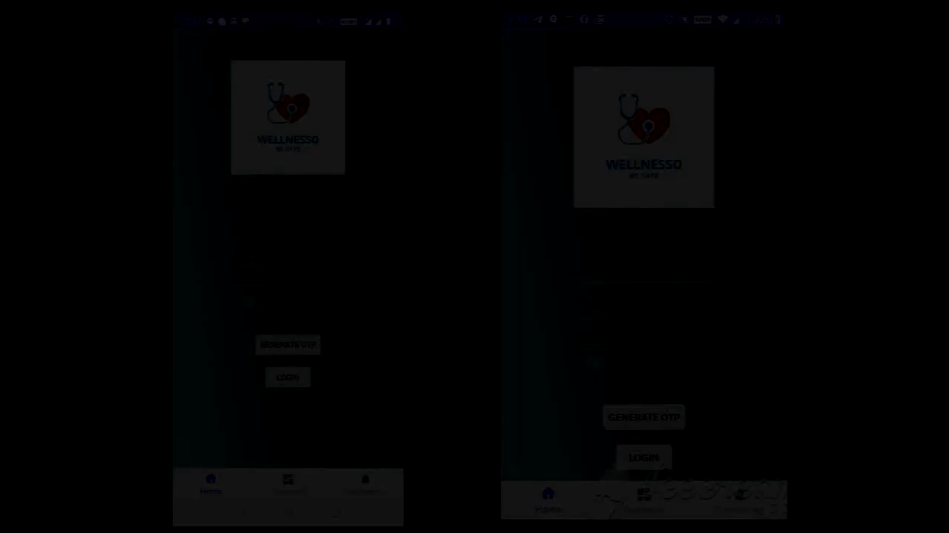
Android Native App Demo Video

Slide 16
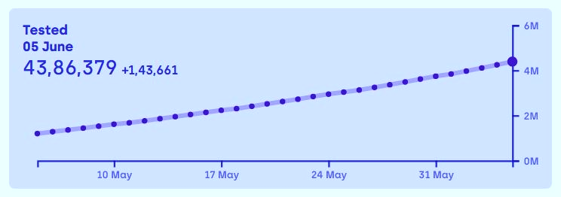
The Exponential rise in Number of infected people is also not yet controlled.
As a solution Wellness queue can smoothen the process to a great extent so that all affected people are addressed

Slide 17

What is Next?

Slide 18
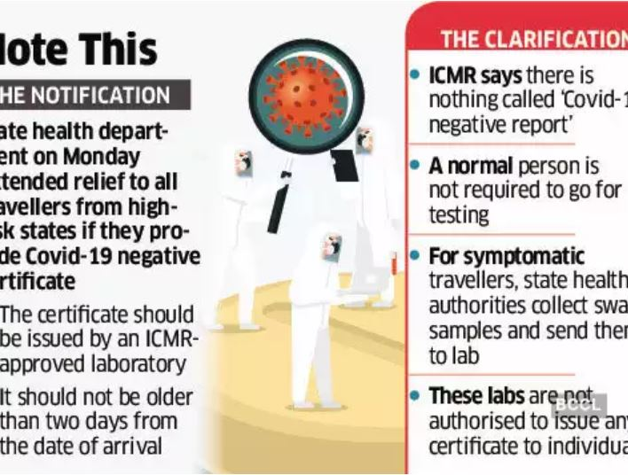
Certificate of confirmation
The ID shared during the sample collection ICMR server has the result of the lab test.
WellnessQ App will help to issue confirmation certificate which will be useful for the people who want o avail transport services.
Extended Feature Of WellnessQ

Slide 19

Future scope
Wait is over?
Patient in Pain should never go through additional burden of stress of waiting and not knowing
* Useful in every industrial sector where the supply of services is limited as per the demand of getting the services.
WellnessQ Extended feature will recommend how much time you need to wait depending on the duration of visit and distance from user location to the health center
Another feature to this application is collection of test reports as a certificate of confirmation after every lab test so that Patient won’t have to wait for lab results
WellnessQ Will be useful even after pandemic

Slide 20





Thank You
Team Binary Nova
+91-9556455437
astitipr@in.ibm.com, supsinha@in.ibm.com
Git Link

